Slide 1



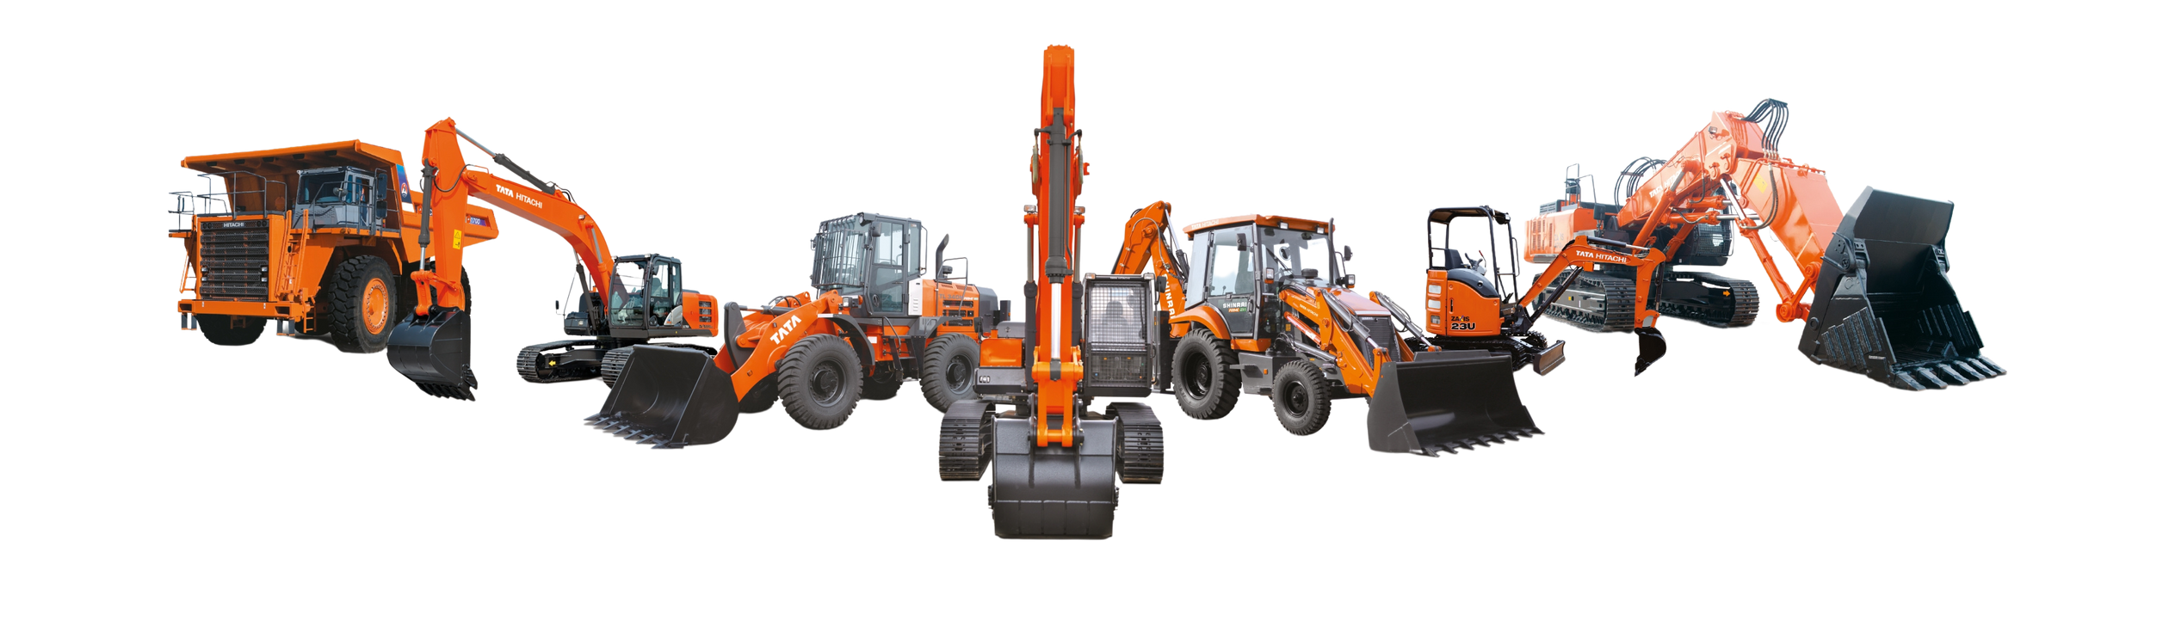

Slide 2



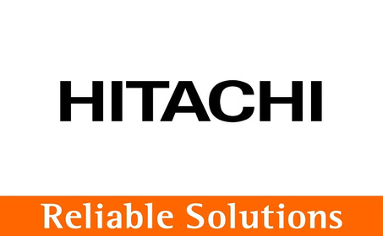


ABOUT US
Tata Hitachi Construction Machinery Company Private Limited is a leading name in the Indian construction equipment industry.
A joint venture between Tata Motors (40%) and Hitachi Construction Machinery, Japan (60%).

Slide 3


OUR VISION & MISSION
VISION
Reliable Solutions for Building a Greater Tomorrow.
MISSION
Be the preferred partner for providing reliable solutions for mining and infrastructure sectors. While dominating the domestic market, we will become a global manufacturing and development hub.
Our hallmark shall be our motivated people, customer centric culture, superior technologies and strong partnerships, all working safely in unison with environment and society.

Slide 4



OUR GUIDING PRINCIPLES
Right machine at the
right time
Fix it right the first time
Quality is not only what
we produce; Quality is
what we deliver

Slide 5
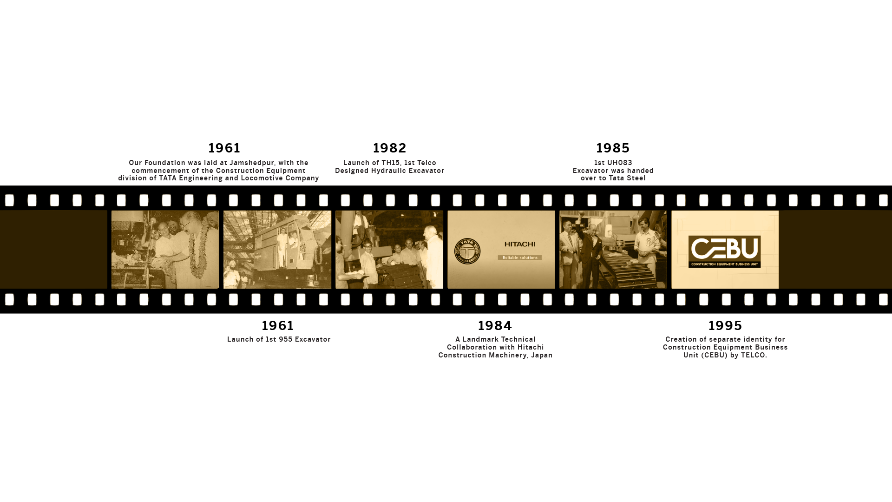
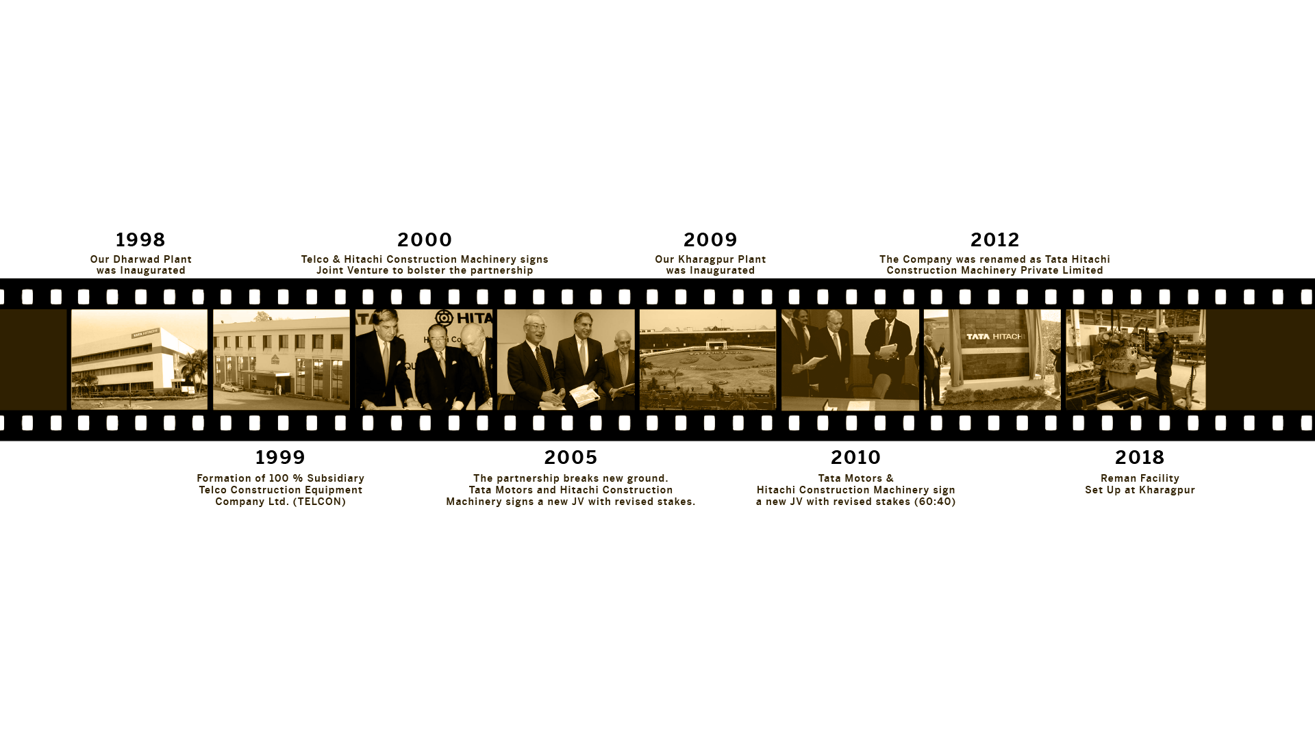
OUR JOURNEY
1961
1982
1985
Our Foundation was laid at Jamshedpur, with the
commencement of the Construction Equipment
division of TATA Engineering and Locomotive Company
Launch of TH15, 1st Telco
Designed Hydraulic Excavator
1st UH083
Excavator was handed
over to Tata Steel
1961
1984
1984
Launch of 1st Excavator
A Landmark Technical
Collaboration with Hitachi
Construction Machinery, Japan
Creation of separate identity for
Construction Equipment Business
Unit (CEBU) by TELCO.
1998
2000
2009
2012
Our Dharwad Plant
was Inaugurated
Telco & Hitachi Construction Machinery signs
Joint Venture to bolster the partnership
Our Kharagpur Plant
was Inaugurated
The Company was renamed as Tata Hitachi
Construction Machinery Private Limited
1999
2005
2010
2018
Formation of 100% Subsidiary
Telco Construction Equipment
Company Ltd. (TELCON)
The Partnership breaks new ground.
Tata Motors and Hitachi Construction
Machinery signs a new JV with revised stakes.
Tata Motors &
Hitachi Construction Machinery Sign
a new JV with revised stakes (60:40)
Reman Facility
Set Up at Kharagpur

Slide 6
OUR PRODUCTS
Mini Excavators
Construction Excavators
Mining Excavators
Backhoe Loader
Wheel Loader
Dump Truck
Attachments

Slide 7
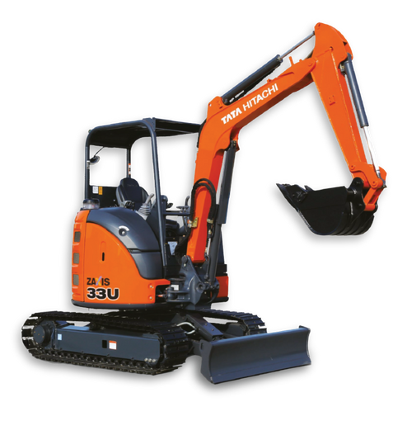
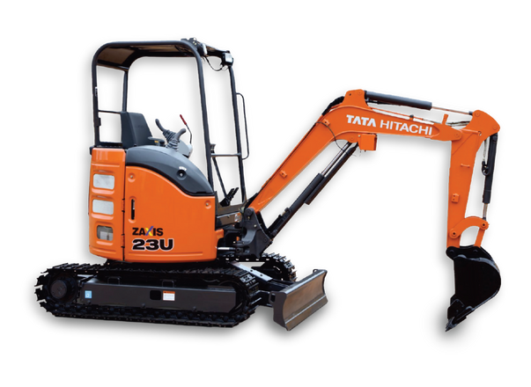
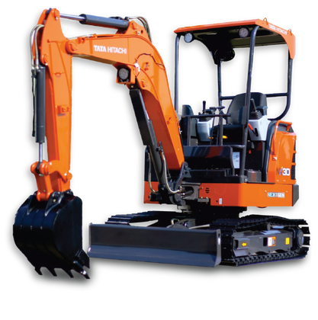
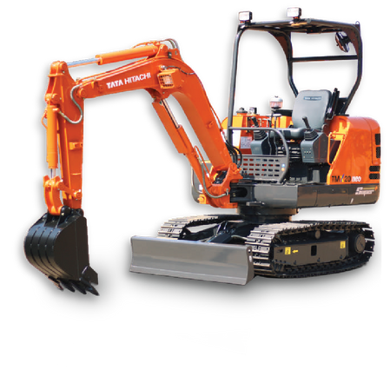

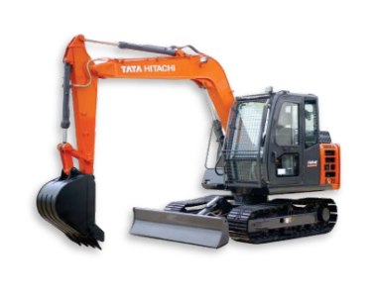
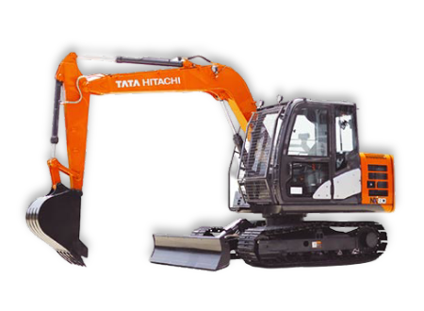
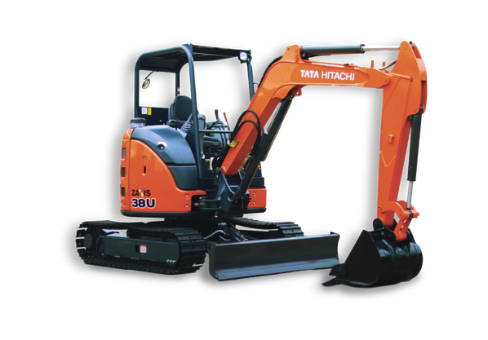
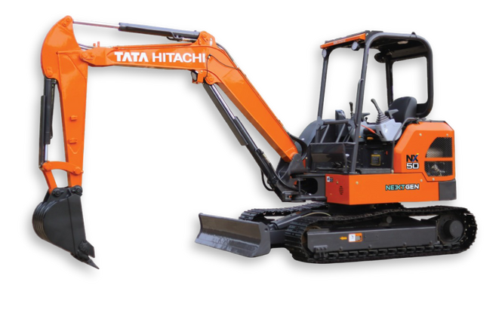
MINI EXCAVATORS
TMX 20 neo
ZAXIS 23U
NX 30
ZAXIS 33U
ZAXIS 38U
NX 50
EX 70 Prime
NX 80

Slide 8
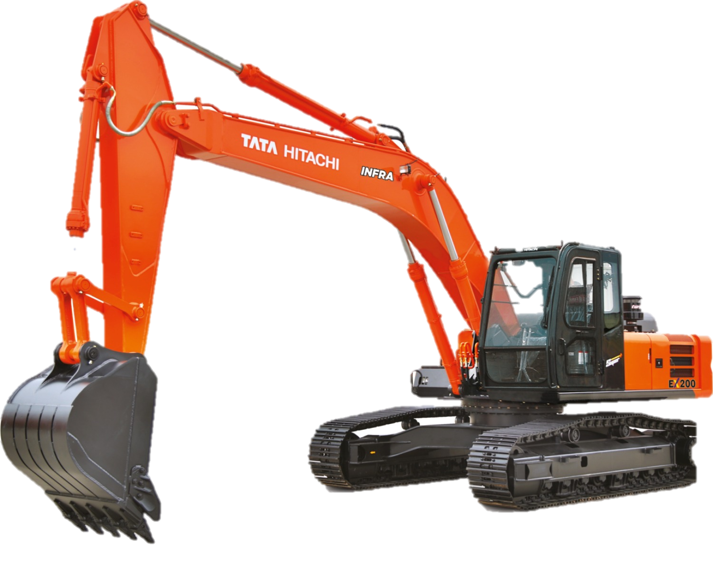
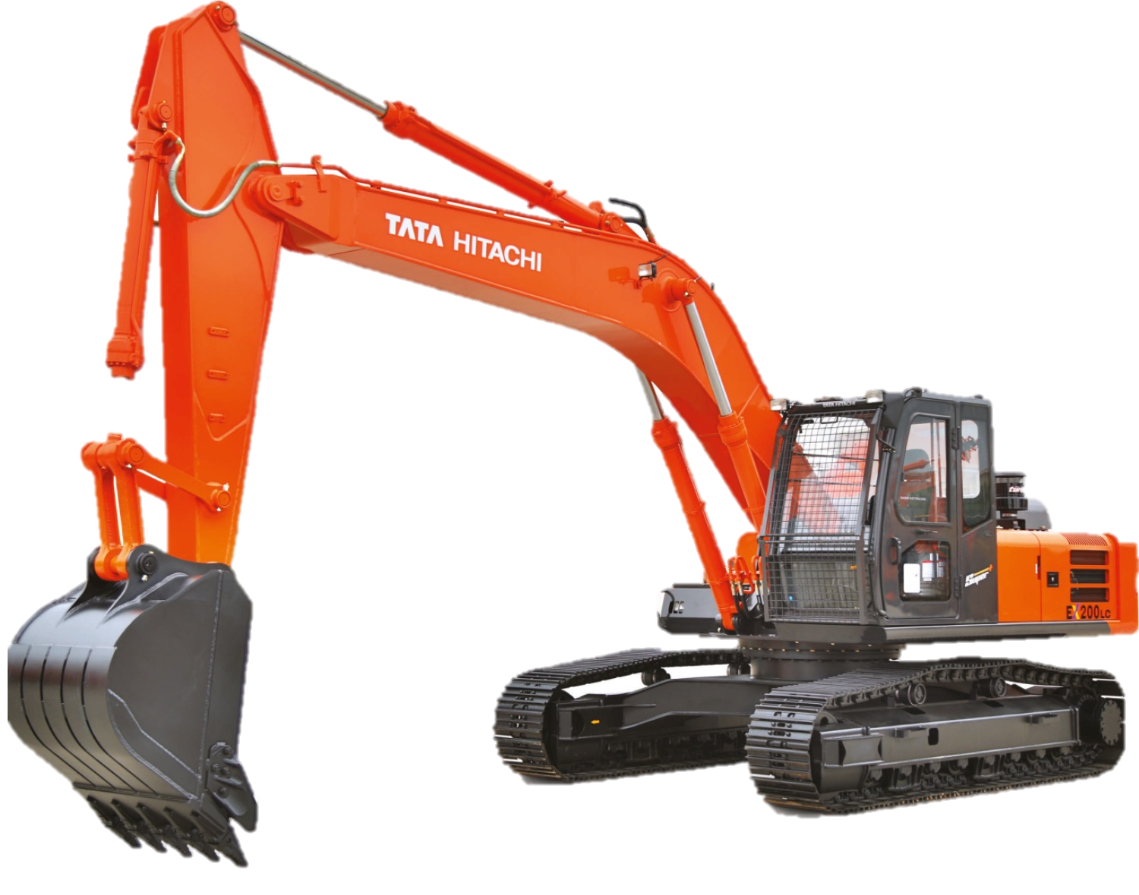
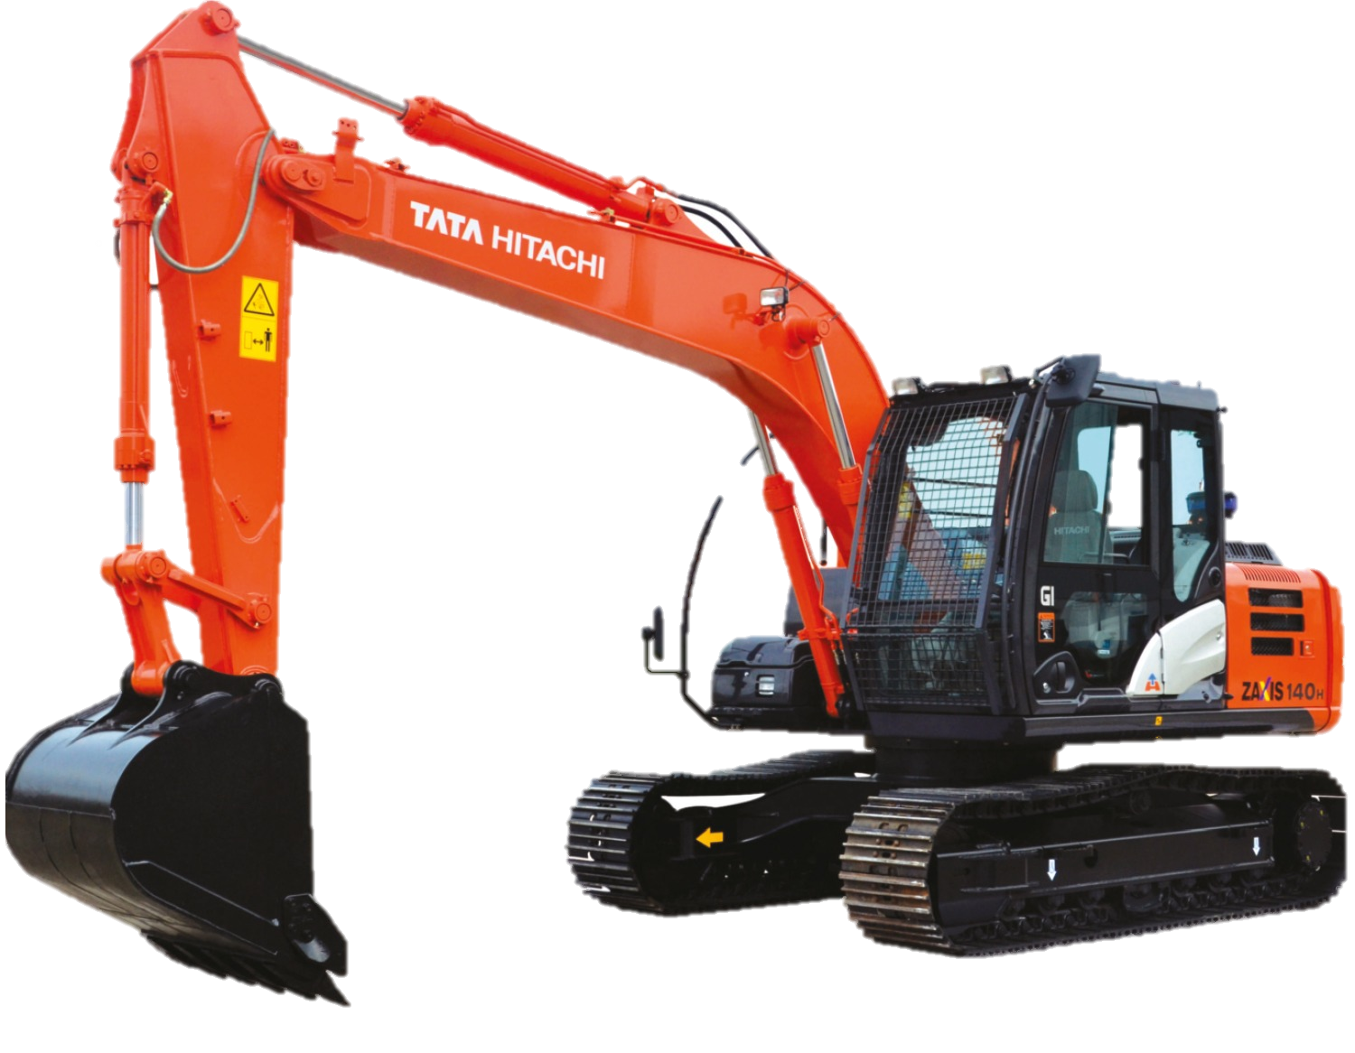
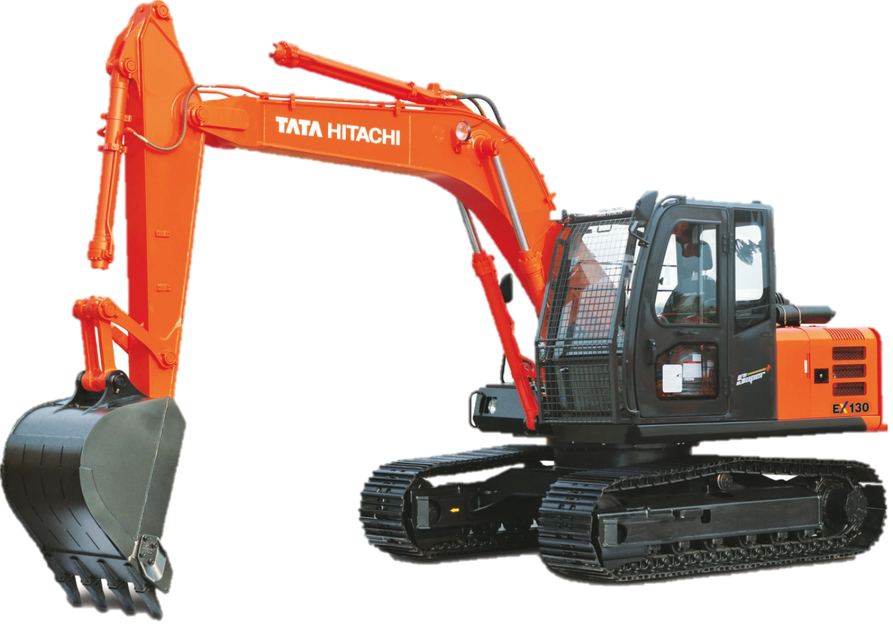
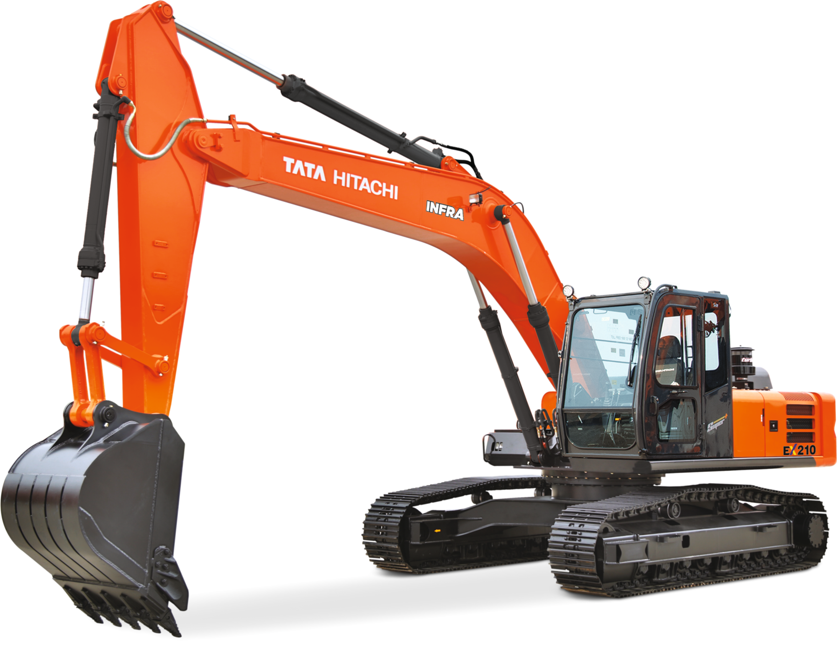
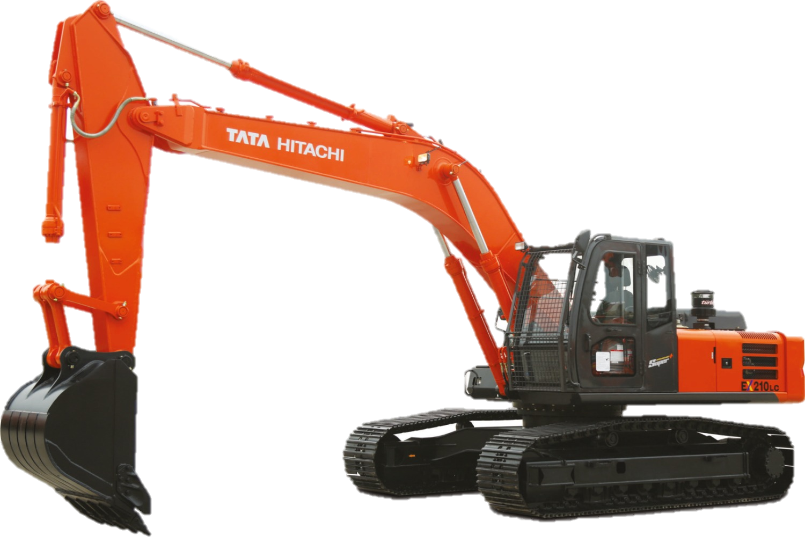
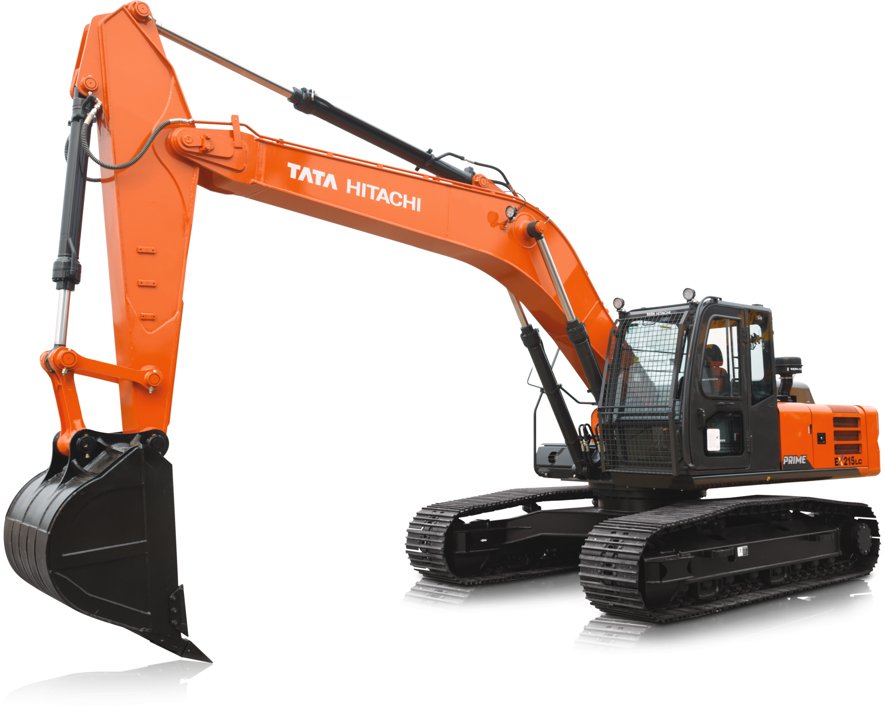
CONSTRUCTION EXCAVATORS
EX 130 Prime
ZAXIS 140H Ultra
EX 200 Infra
EX 200LC Prime
EX 210 Infra
EX 210LC Prime
EX 215LC Prime

Slide 9
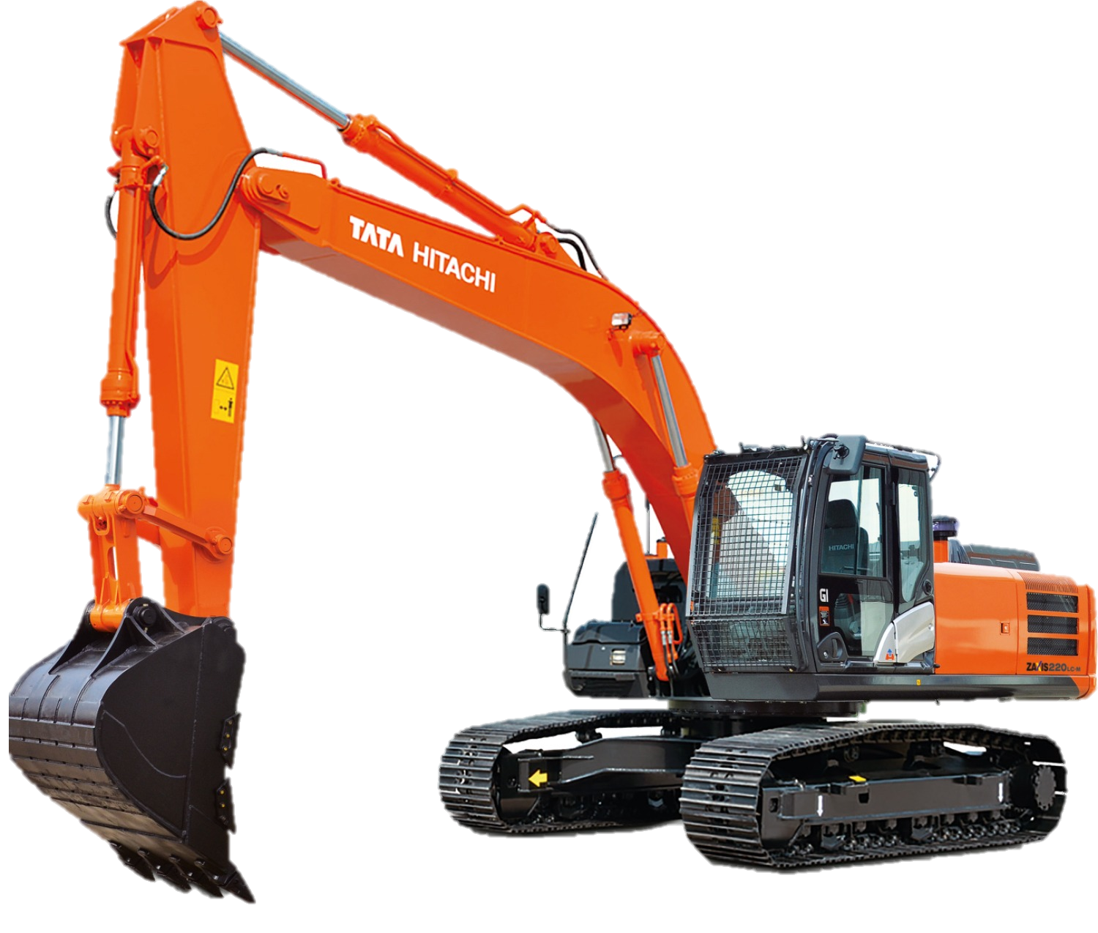
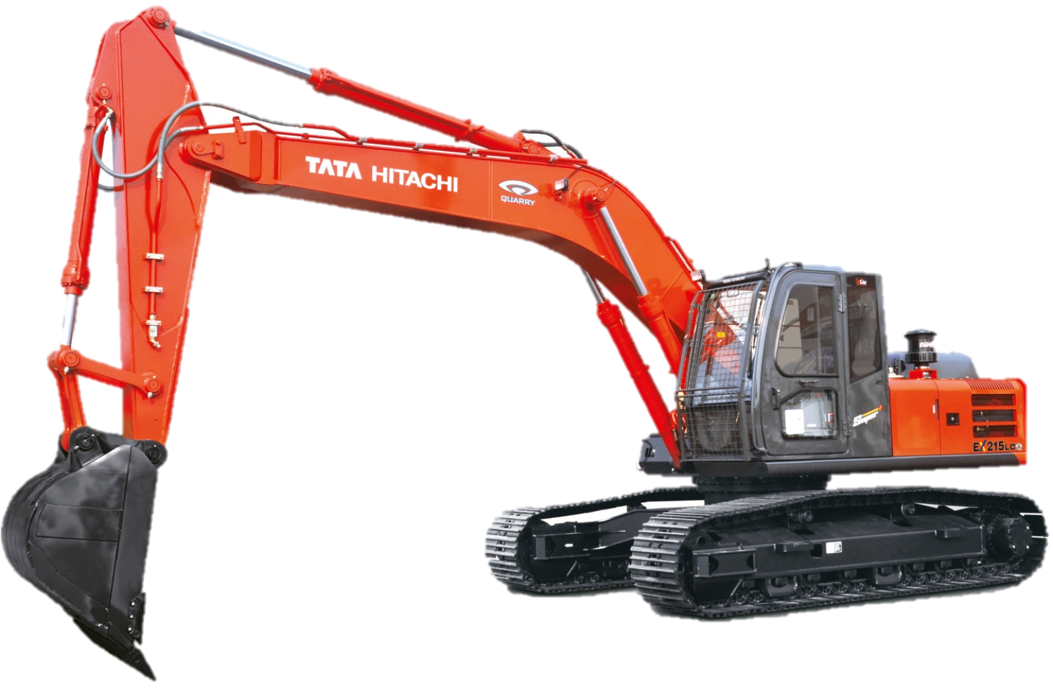
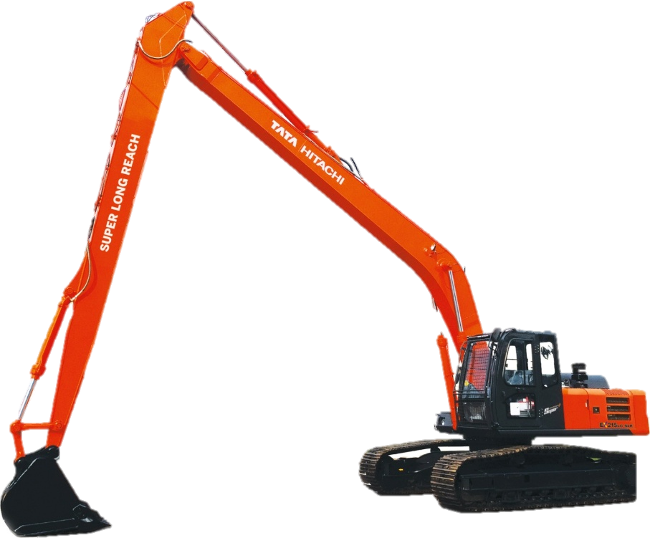
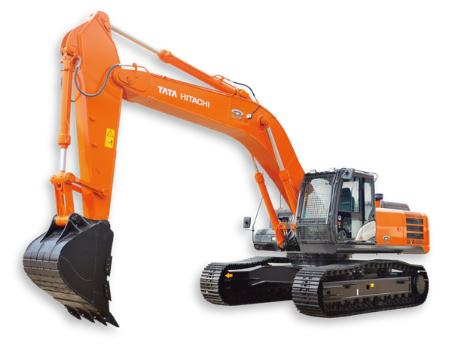
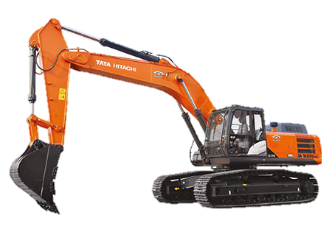
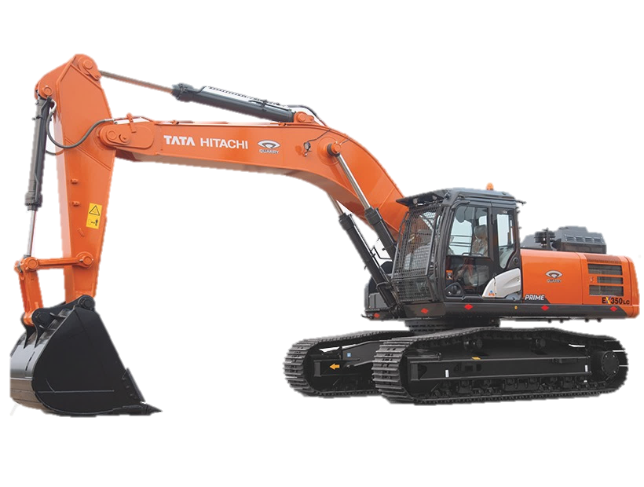
CONSTRUCTION EXCAVATORS
EX 215 LCQ Prime
ZAXIS 215LC SLR Prime
ZAXIS 220LC Ultra
EX 350LC Prime
ZAXIS 370LCH Ultra
ZAXIS 400MTH

Slide 10
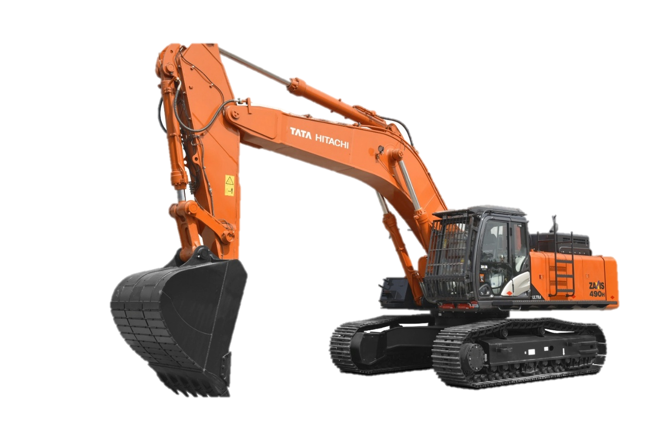
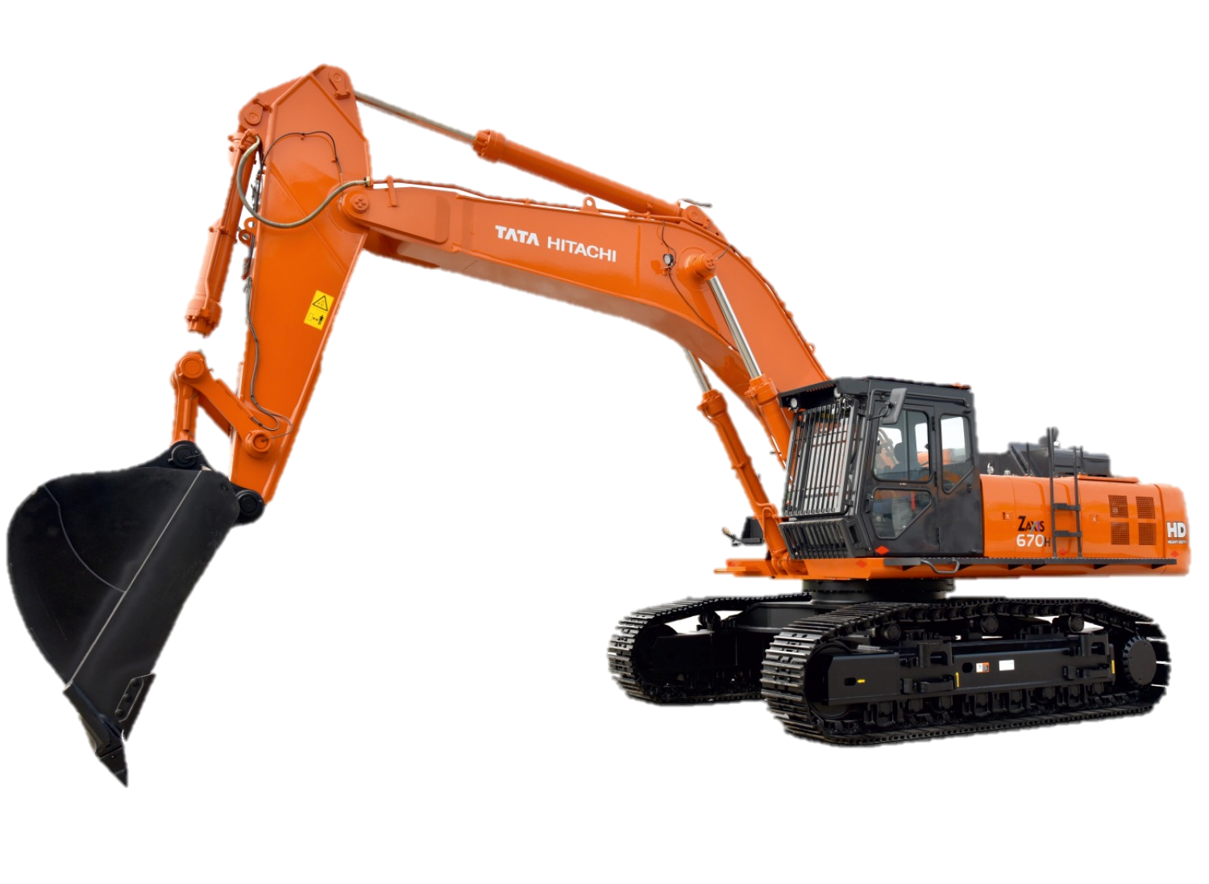
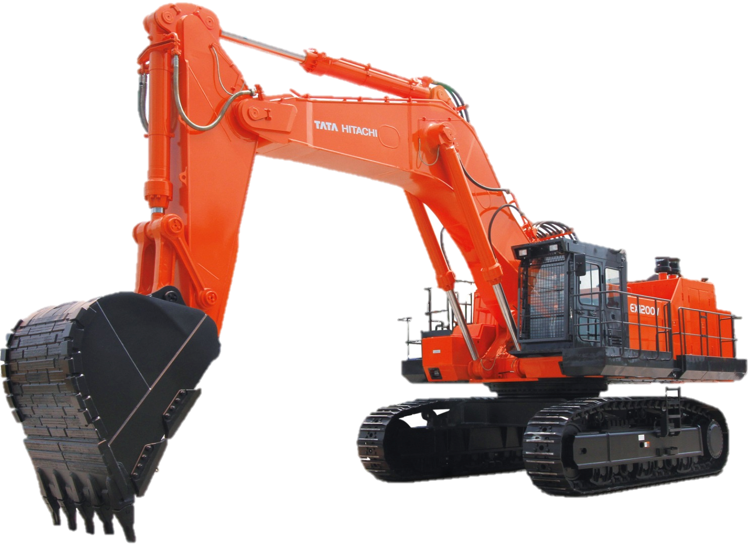
MINING EXCAVATORS
ZAXIS 490H Ultra
ZAXIS 670 H
EX 1200

Slide 11
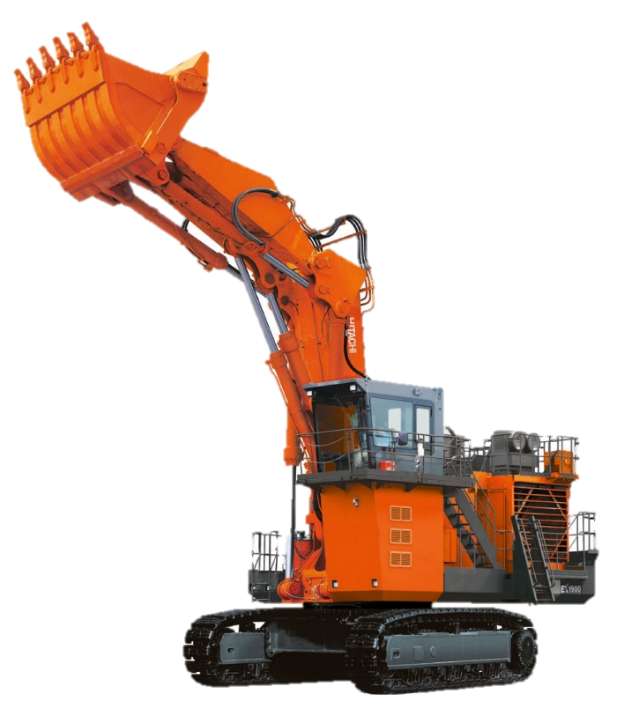
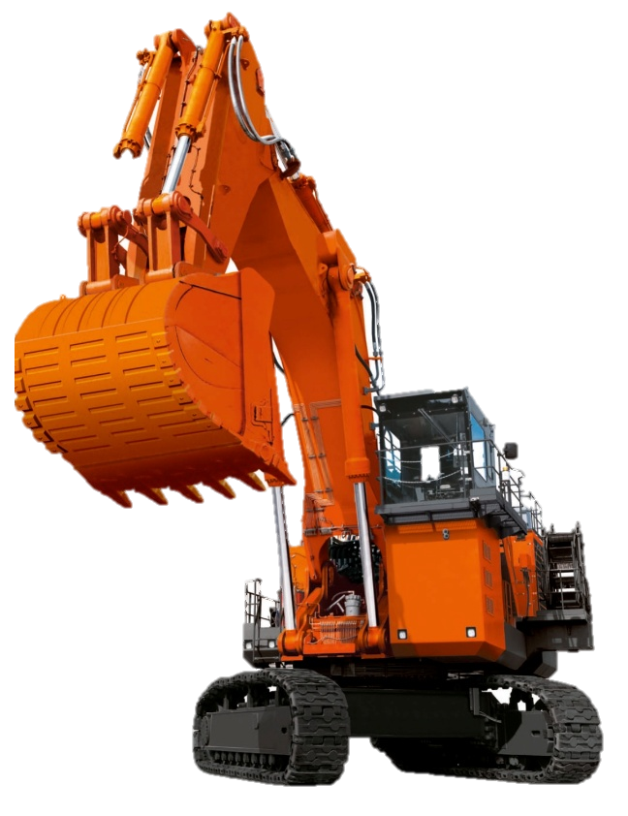
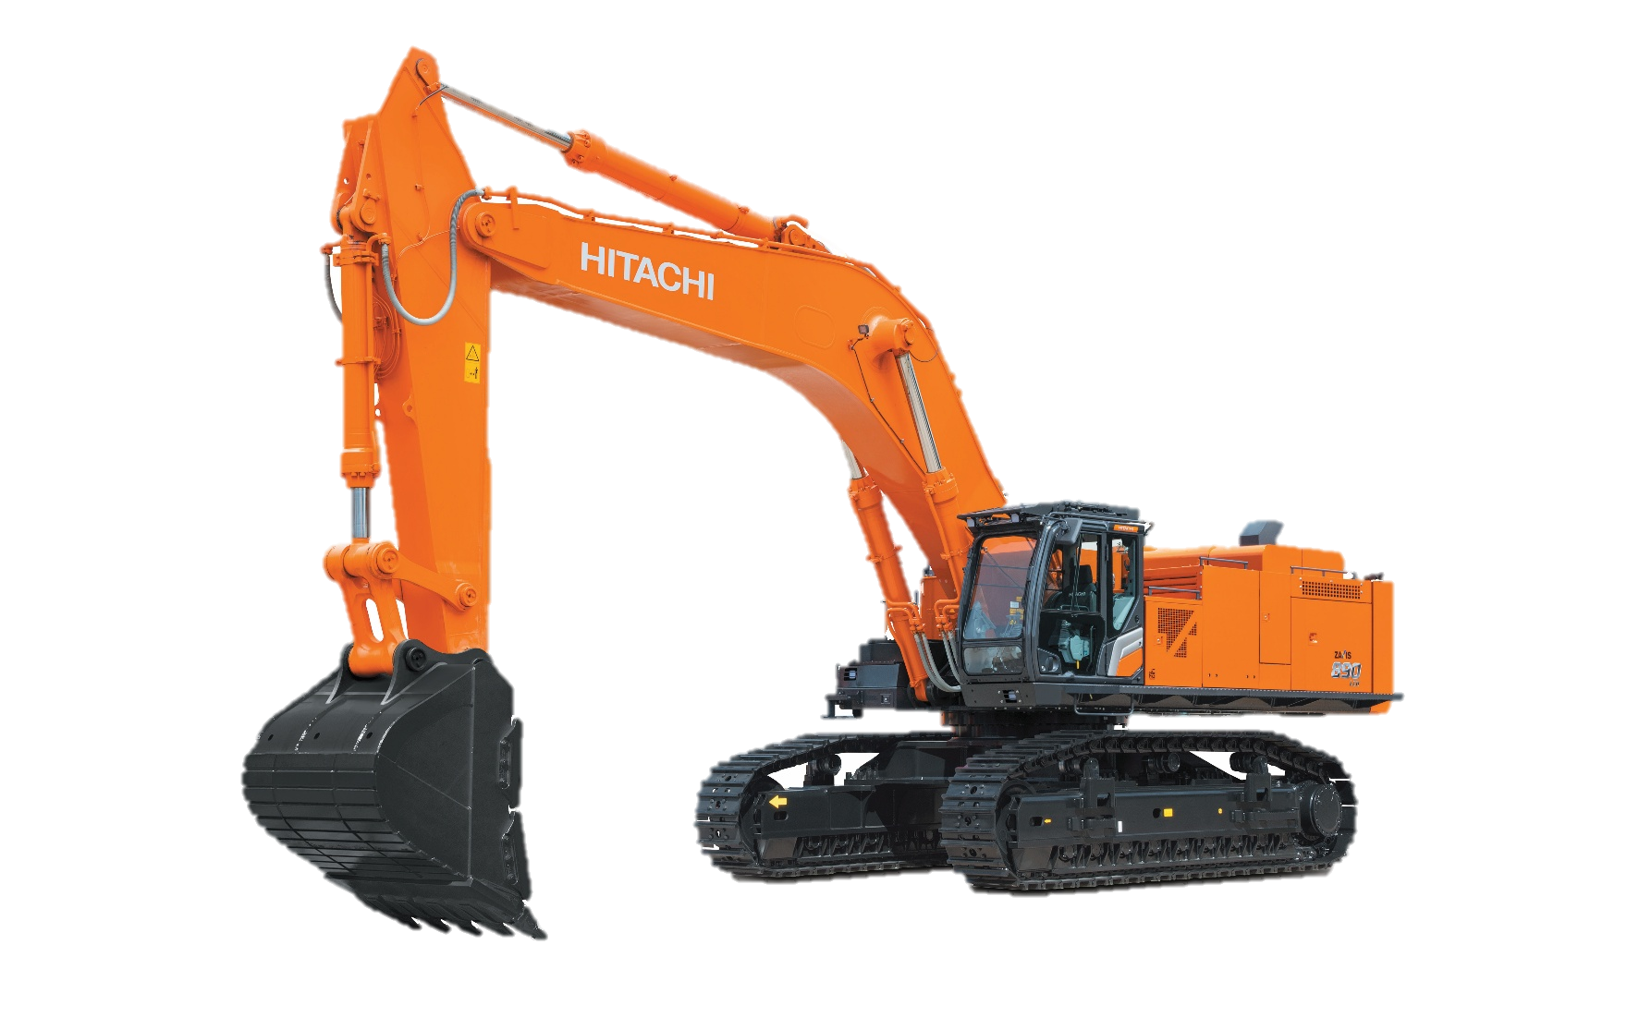
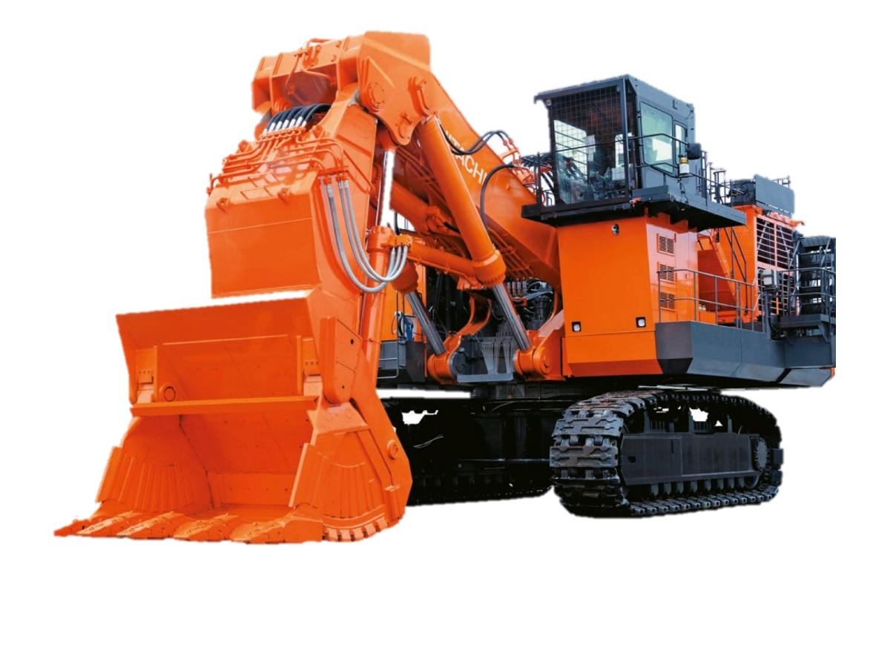
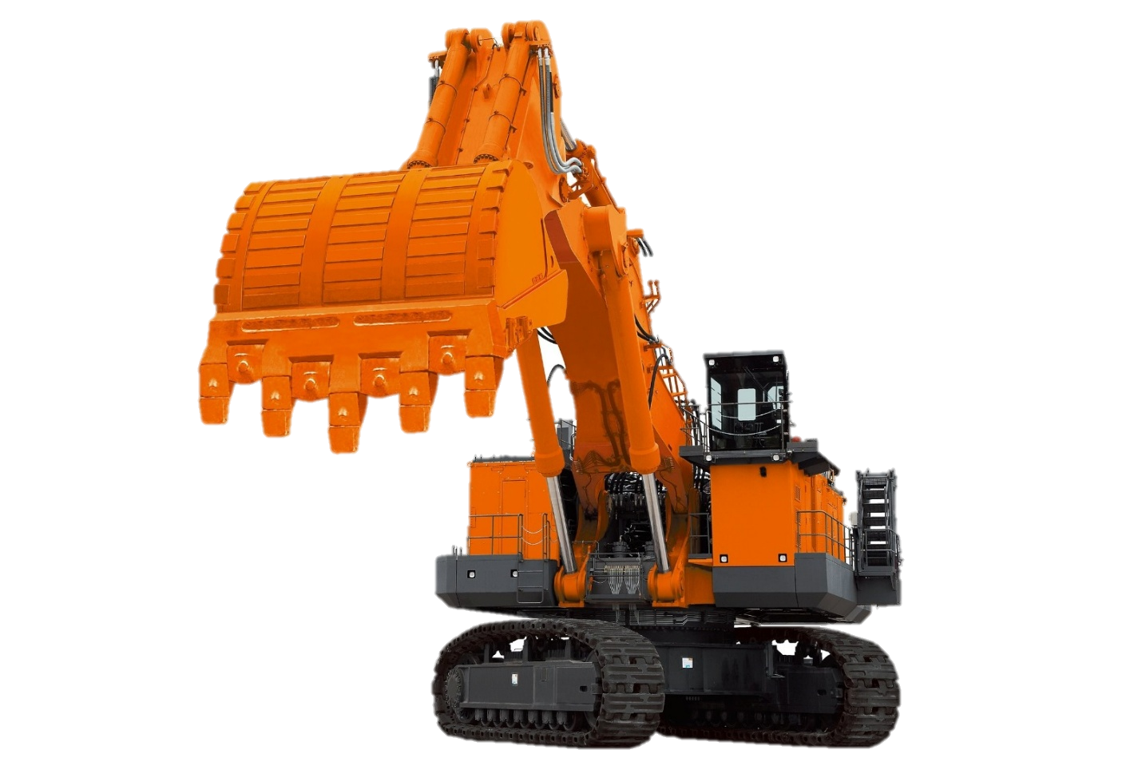
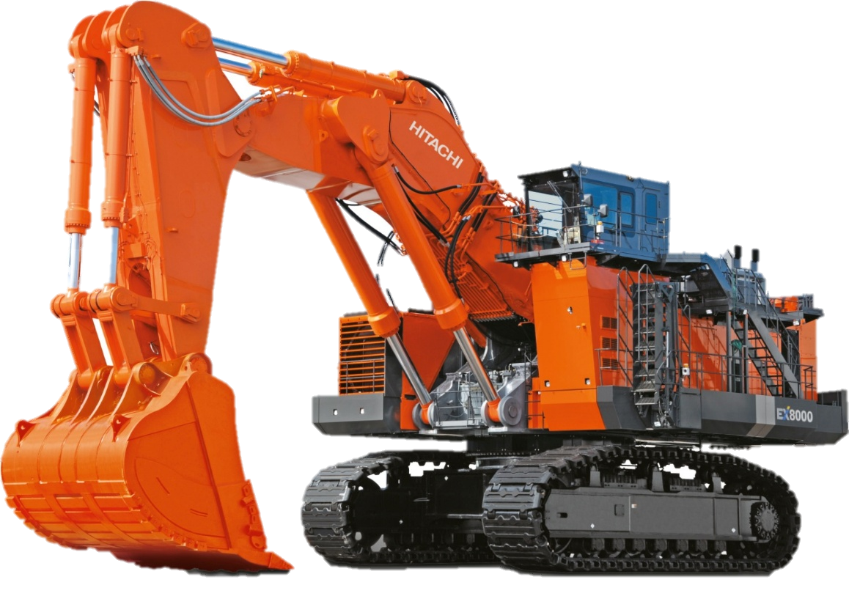
MINING EXCAVATORS
Imported Mining Excavators from Hitachi Construction Machinery, Japan
ZAXIS 890H Ultra
EX 1900-6
EX 2600-7/6
EX 3600-7
EX 5600-7
EX 8000-7

Slide 12
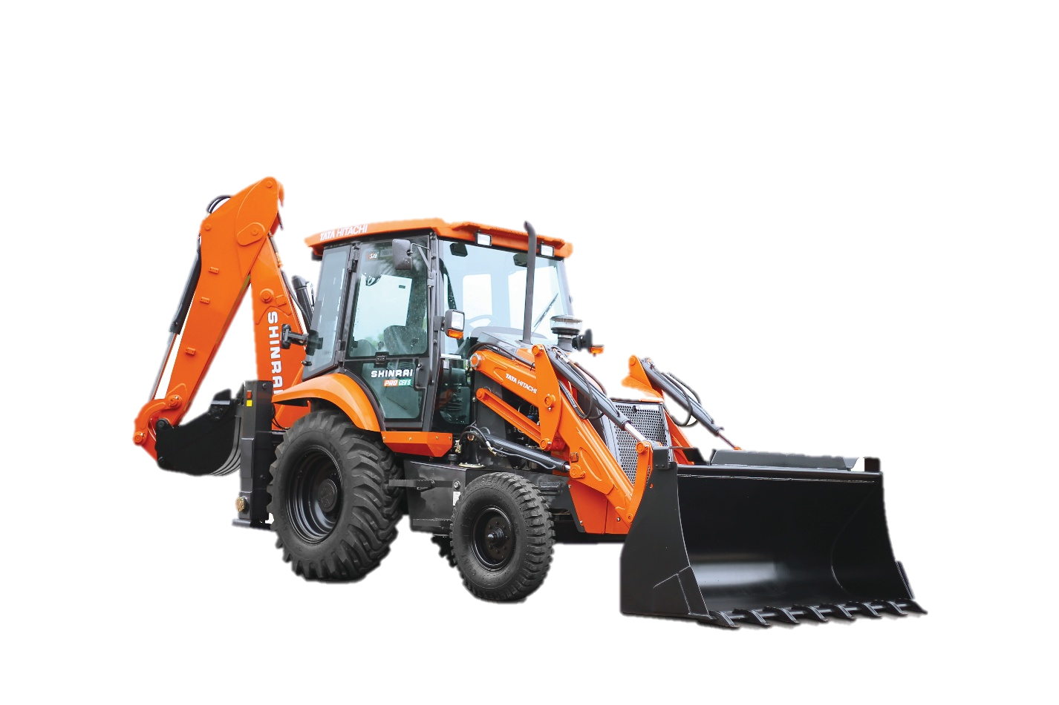
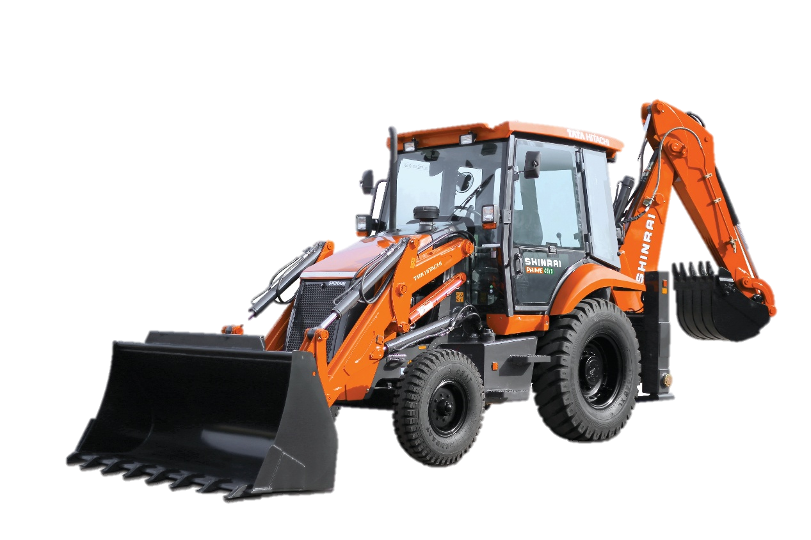
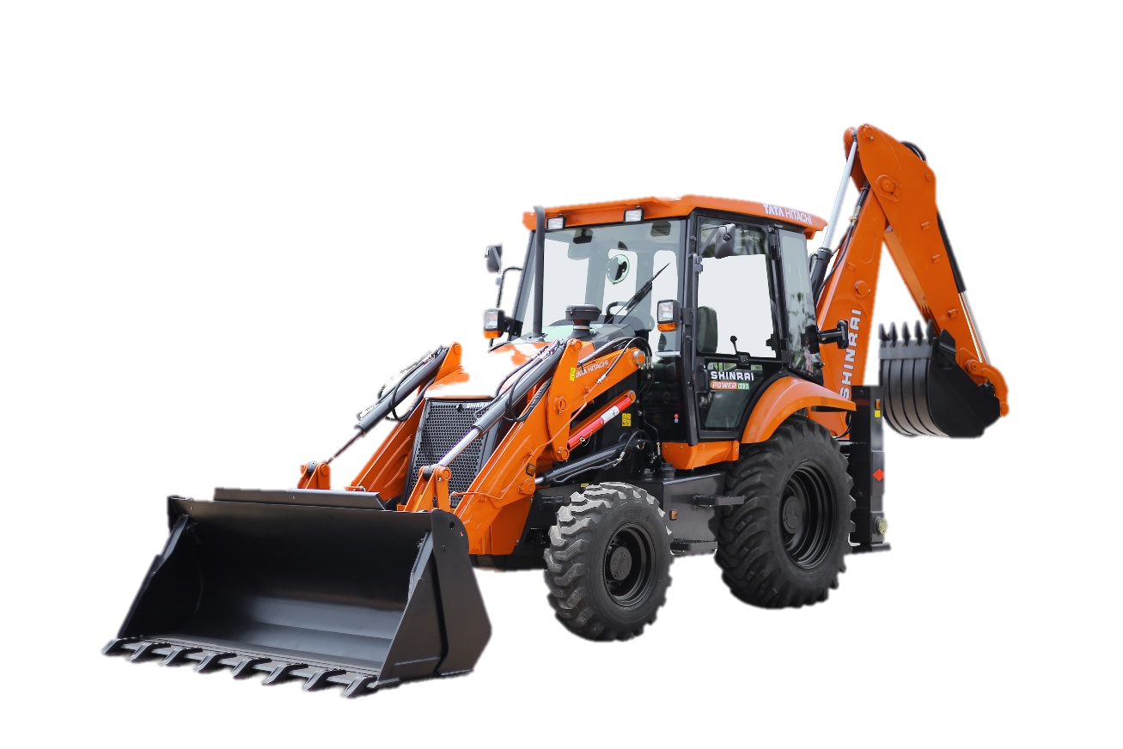
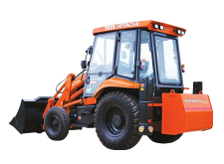
BACKHOE LOADERS
SHINRAI Pro
SHINRAI Prime
SHINRAI Power
SHINRAI Prime Loader

Slide 13
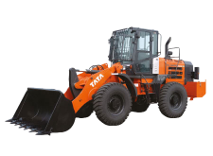
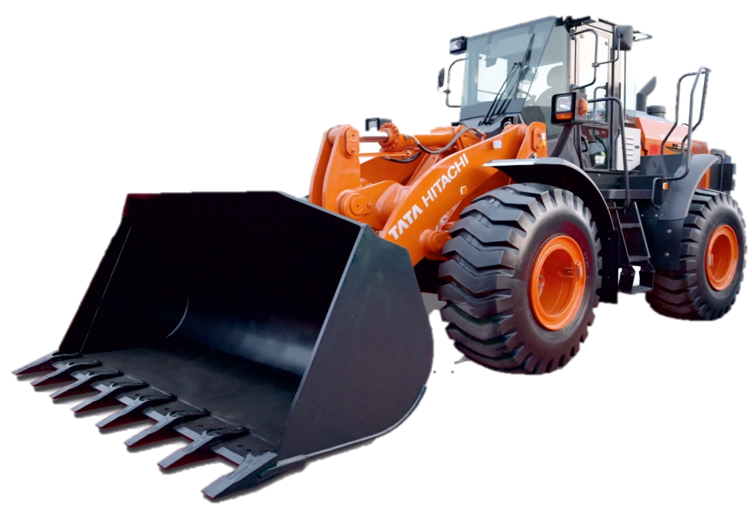
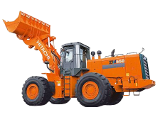
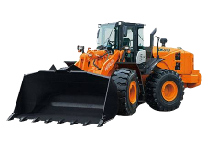
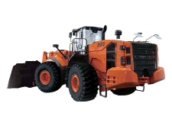
WHEEL LOADERS
ZW 225
TL 340H Prime
Imported Wheel Loaders from Hitachi Construction Machinery, Japan
ZW 310-5A
ZW 370-5A
ZW 550

Slide 14
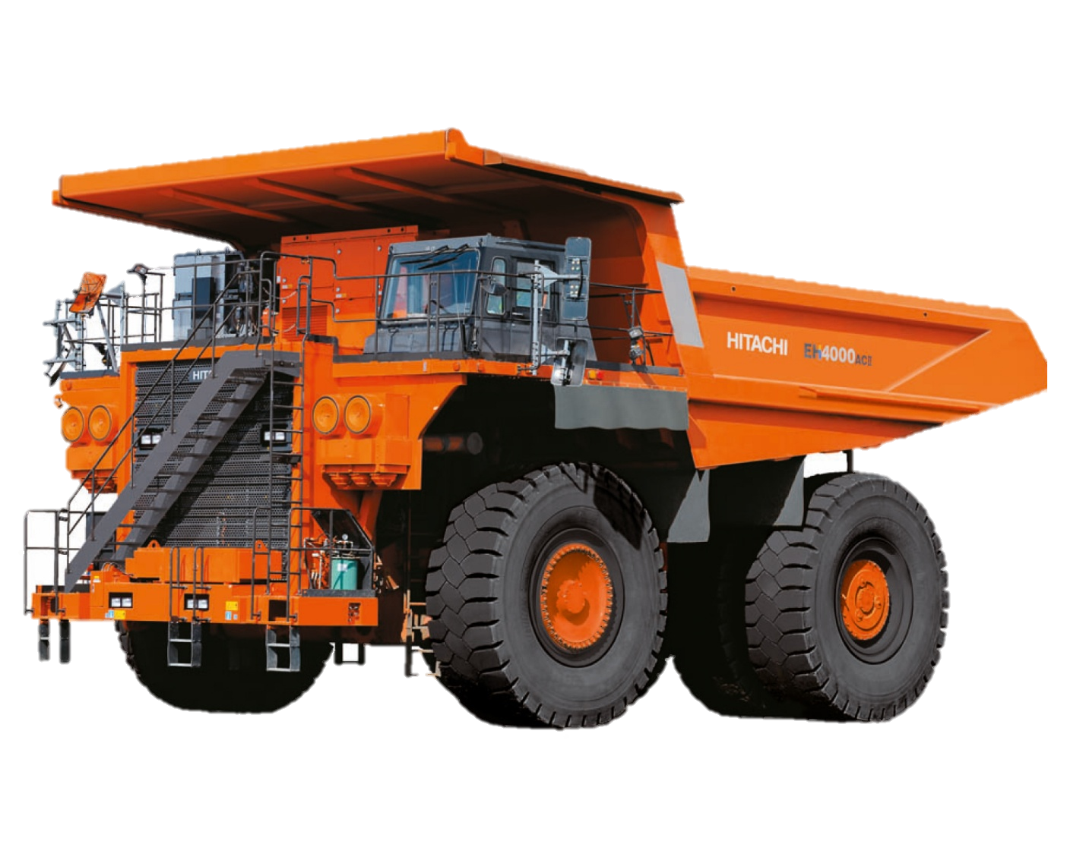
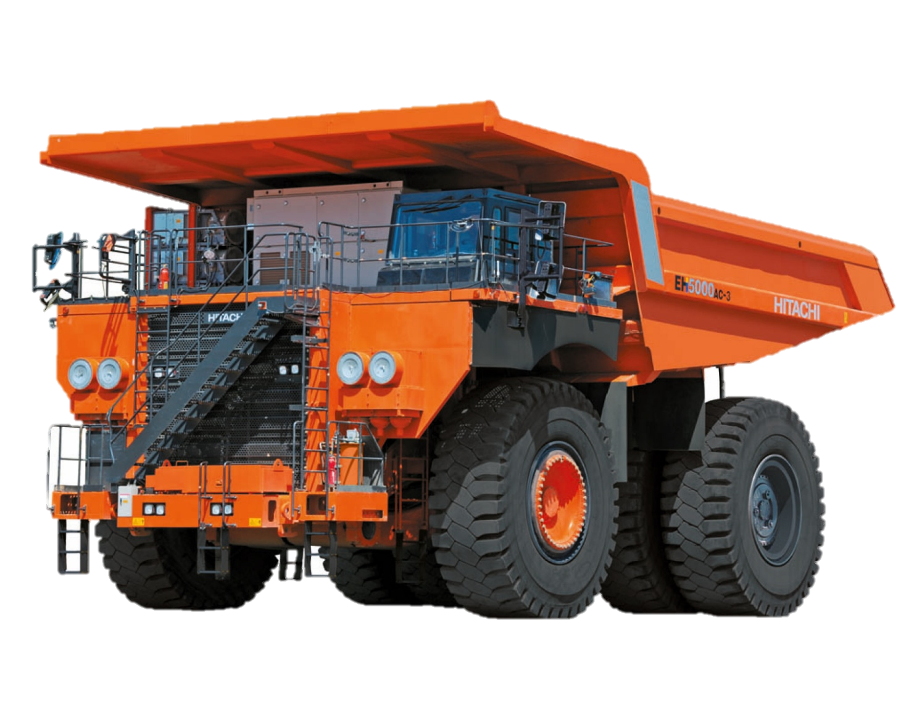
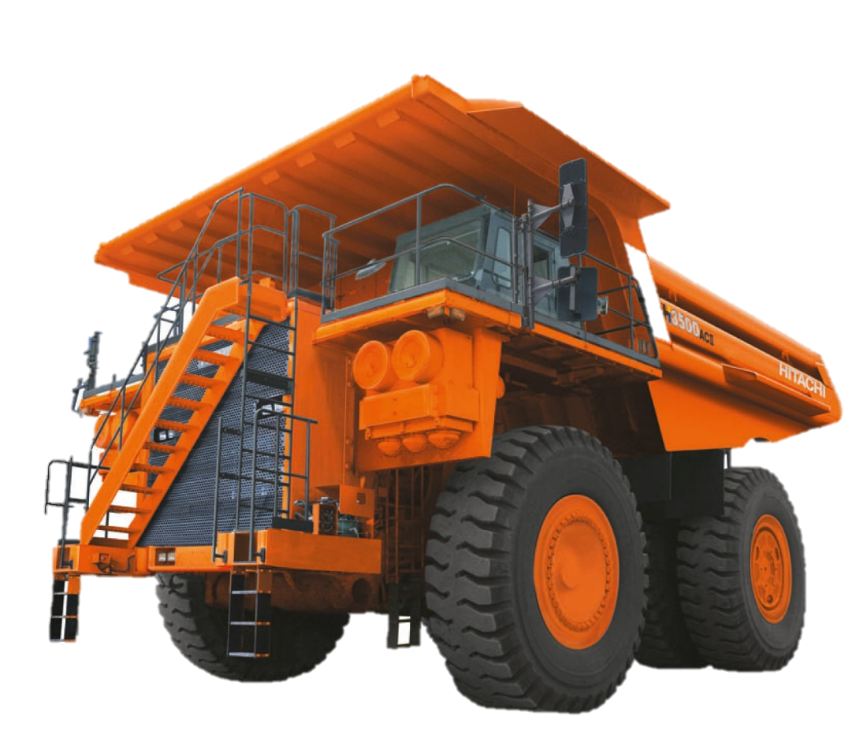
DUMP TRUCKS
Imported Wheel Loaders from Hitachi Construction Machinery, Japan
EH 3500AC-3
EH 4000AC-3
EH 5000AC-3

Slide 15
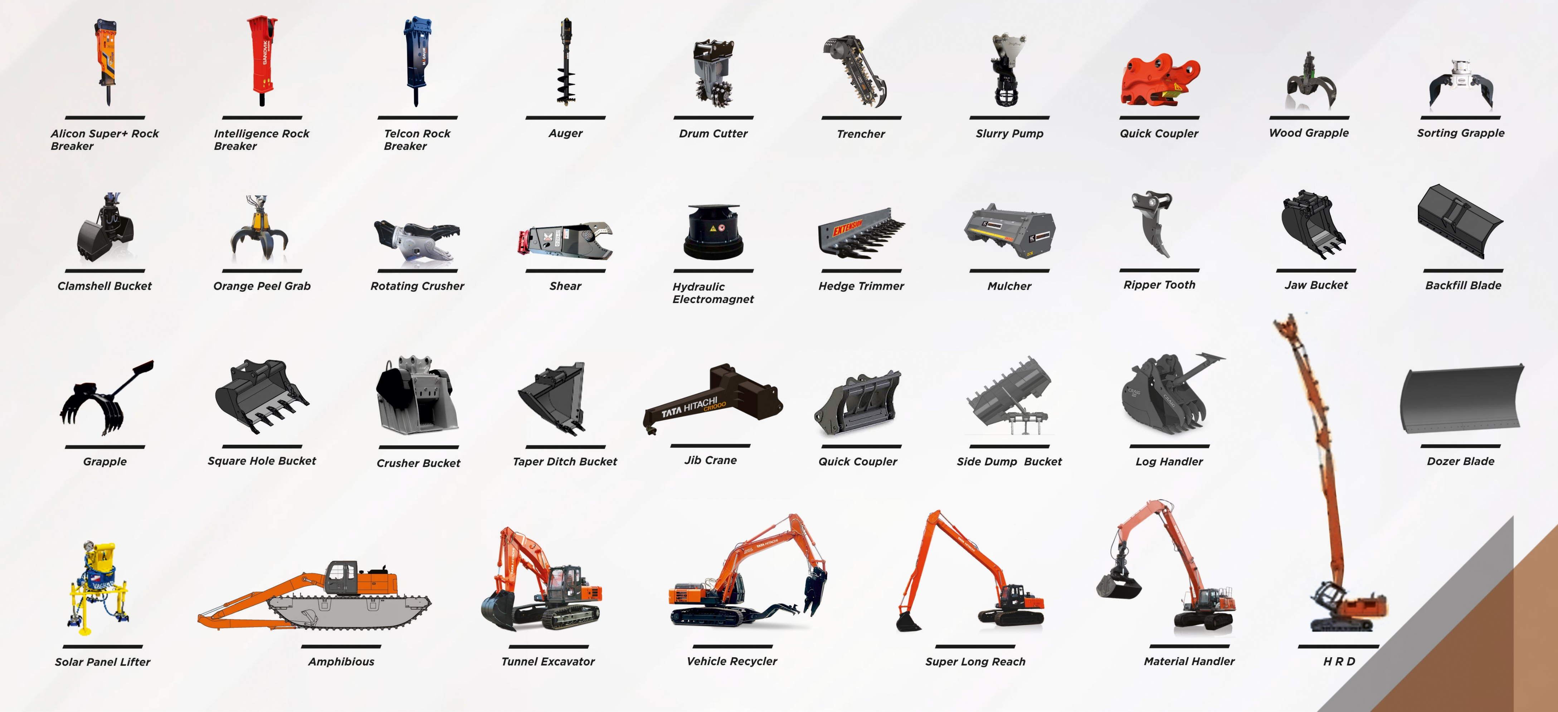
ATTACHMENTS

Slide 16
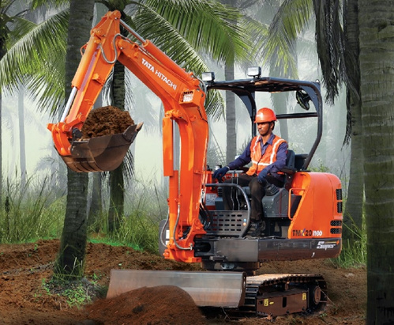
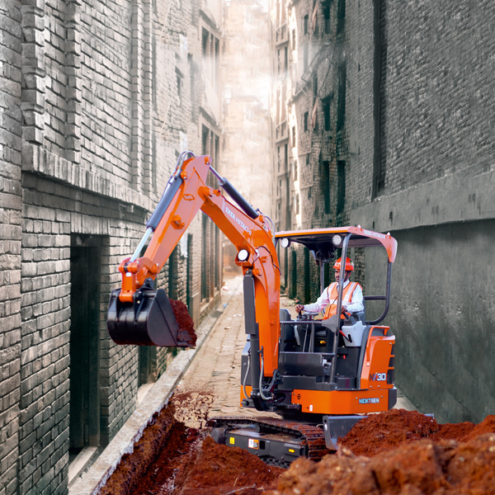
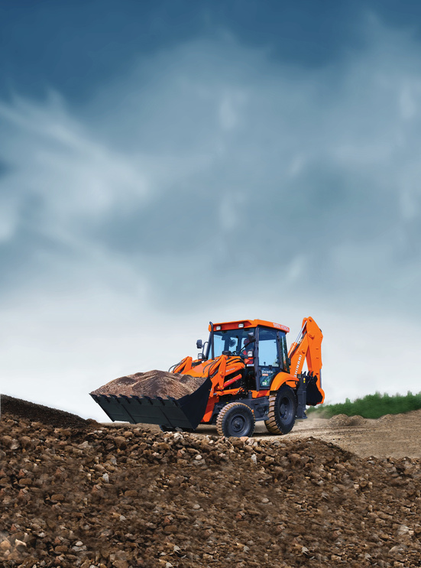







MACHINES AND ATTACHMENTS SUITABLE FOR A VARIETY OF APPLICATIONS
Plantation / Agriculture
Urban Infrastructure
General Construction
Stone Crusher
Material Handling
Irrigation
Well Digging
Stone Quarry
Granite Mining
OB Removal

Slide 17








OUR MANUFACTURING FACILITIES
Our products are proudly engineered across two state-of-the-art facilities - one in Dharwad, Karnataka,
and the other in Kharagpur, West Bengal - our manufacturing backbone ensures precision, consistency, and scale in every product we deliver.
DHARWAD
KHARAGPUR

Slide 18






OUR NETWORK
At Tata Hitachi, we prioritize our outreach to customers through a strong distribution network that aids in the servicing and selling of products.
TATA HITACHI NETWORK
LARGE NETWORK OF DEALERSHIPS
1.
Zonal Offices: 10
Branch Offices: 25
Parts Main Warehouse: Nagpur
Other Parts Warehouses: Dharwad, Kharagpur, and Dharuhera
1.
Dealers:
Domestic: 52
International: 3
2.
3.
2.
Touch Points: 305
4.
INTEGRATED DEALERSHIP FACILITY
Experience a complete ownership journey under one roof
FACILITY OVERVIEW
EXPERIENCE ZONE
SPARE PARTS WAREHOUSE
MACHINE CARE FACILITY

Slide 19










AFTER SALES SUPPORT
CONSTRUCTION SERVICE
MINING SERVICE
GENUINE SPARE PARTS
Our service commitment guarantees operational efficiency and customer satisfaction across every project
Tata Hitachi delivers specialized service solutions for mining equipment, ensuring maximum uptime in the most demanding conditions
Tata Hitachi offers genuine spare parts that ensure reliability, performance, and longer equipment life. Backed by a robust distribution network, we ensure quick and consistent availability

Slide 20





DIGITAL SUPPORT SERVICES
We’ve embedded telematics such as ConSite in our Ultra series Excavators and InSite in our
EX Prime, Infra series Excavators, Backhoe Loaders, and Wheel Loaders. Helping optimize fleet utilization, ease equipment management, enhance safety, monitor machine health, and improve maintenance
resulting in significant savings.
e-DOST is a one stop solution for your construction equipment related requirements. This e-commerce platform provides solutions for service, genuine spare parts, and many other needs.

Slide 21







VALUE ADDED SERVICES
CERTIFIED USED EQUIPMENT
RENTALS
REMAN
Reliable, refurbished machines that meet Tata Hitachi’s stringent quality standards, offering excellent performance, extended value, and peace of mind at a competitive cost.
A flexible, cost-effective way to access Tata Hitachi machines as needed. Perfect for short-term projects or trial runs, without the long-term ownership commitment.
Remanufactured using genuine parts and expert processes, our components deliver cost savings, long-term reliability, and promote a circular economy through sustainable reuse.

Slide 22











CSR
Our responsibility goes beyond business. At Tata Hitachi, we partner with communities around our facilities to improve quality of life through long-term, need-based initiatives. Guided by our five CSR pillars - Education, Skill Development, Healthcare, Rural Development, and Environment. We’re building stronger communities and a more sustainable future.
We believe in shared progress — where every step forward is one we take together.
Education
Skill Development
Healthcare
Rural Development
Environment

Slide 23





CONTACT US
Website
e - Dost
Used Equipments
Tata Hitachi
Career Portal
facebook.com/TataHitachiCorporate
in.linked.com/company/tatahitachi
instagram.com/tatahitachicorporate

Slide 24


THANK YOU

